Slide 1

OER and MOOCs:
Survey in 20 Non-English-Speaking Countries
Svetlana KNYAZEVA
UNESCO Institute for Information Technologies in Education

Slide 2
OER definition
OER refers to any educational resources (including curriculum maps, course materials, textbooks, streaming videos, multimedia applications, podcasts, and any other materials that have been designed for use in teaching and learning) that are openly available for use by educators and students, without an accompanying need to pay royalties or license fees (Butcher, 2011).
OER can exist as smaller, stand-alone resources (reusable learning objects), that can be mixed and combined to form larger pieces of content or as larger course modules or full courses.
OER can also include simulations, labs, collections, journals, and tools. These materials are considered open if they are released under an open license such as a Creative Commons license.

Slide 3
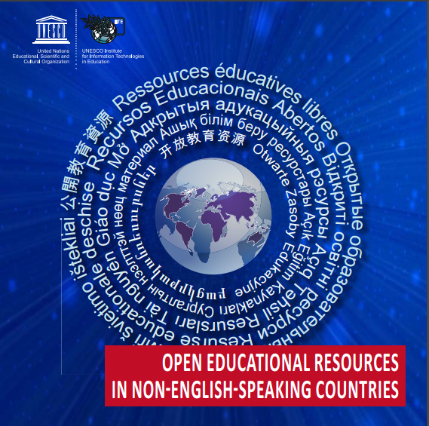
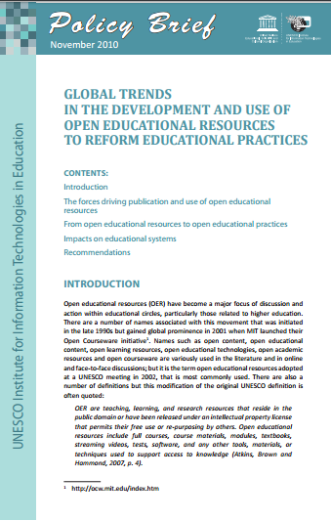

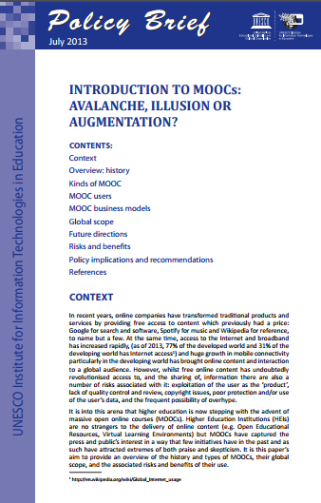
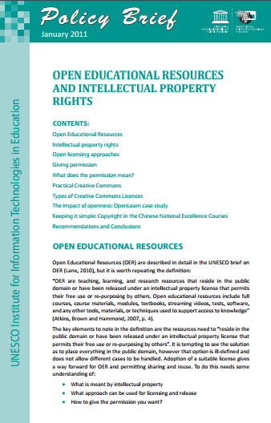
UNESCO IITE project
“OER in non-English-speaking countries”
Armenia | Latvia
Azerbaijan | Lithuania
Belarus | Moldova
Brazil | Mongolia
China | Poland
France | Russia
Japan | Turkey
Kazakhstan | Ukraine
Kenya | Uzbekistan
Kyrgyz Republic | Vietnam

Slide 4

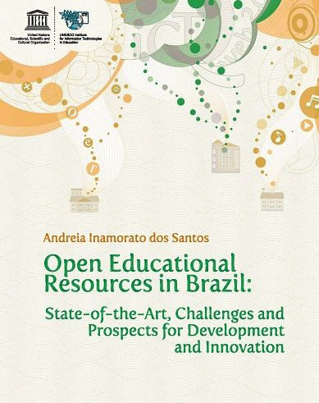
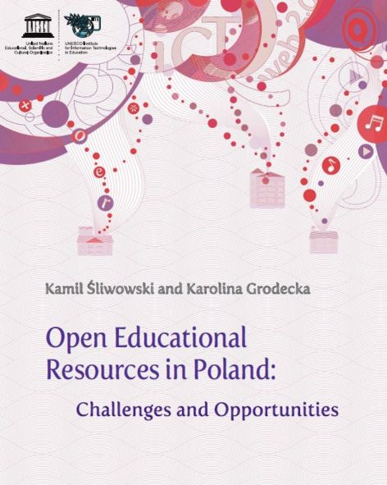

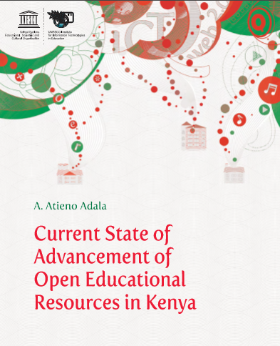
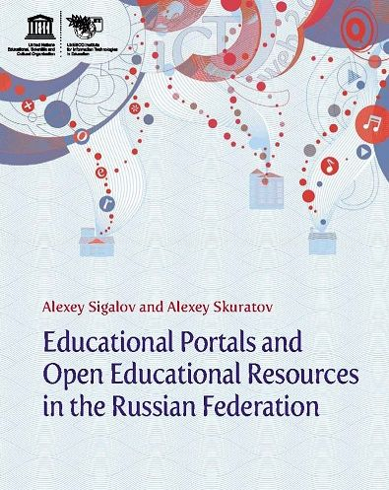

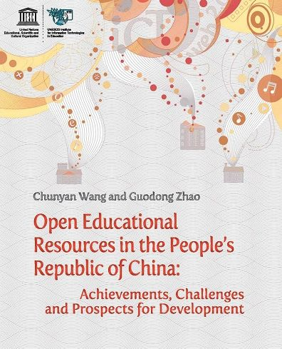

UNESCO IITE project
“OER in non-English-speaking countries”

Slide 5

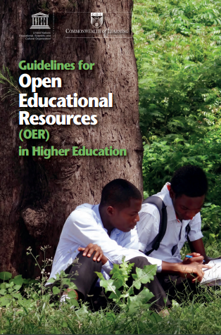
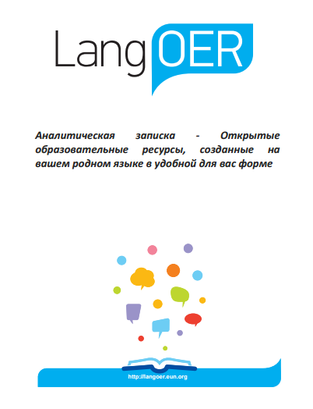
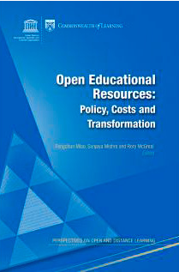
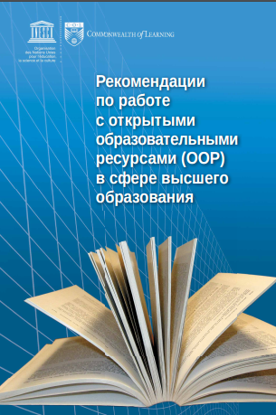
UNESCO IITE project
“OER in non-English-speaking countries”

Slide 6
Findings of UNESCO IITE project
“OER in non-English-speaking countries”
Internal motivations of producers and users of OER
An interest in innovative teaching methods and resources
A willingness to expand the access of students and colleagues to their materials
A desire to enhance the visibility of the university
An opportunity to gain additional recognition and scores during appraisal
Benefits
Potential financial saving due to eliminating the duplication of efforts in the development of teaching materials
The use of OER can have a positive impact on the quality of the education being offered.

Slide 7
Barriers to the development and use of OER
National/institutional strategies for the ICT use in education are mainly oriented towards infrastructure and seldom encourage the development of educational content
Educators often lack awareness about the availability of OER and the opportunities they provide
Most people are not familiar with intellectual property rights; national IPR regulations are often incompatible with open licenses
Emerging pedagogical approaches suggesting the use OER are yet to be adopted by educators and HEIs
Quality assessment and assurance provisions for ensuring OER to be academically and/or pedagogically sound do not exist
The reward/encouragement system for introducing OER into educational practice is non-existent and the provision of OER is not considered during performance evaluation

Slide 8
Barriers to the development and use of OER
Language barrier
Technological Barriers
The ICT infrastructure has developed unevenly within the surveyed countries, and is often insufficient to support the widespread development and sharing of OER. Despite considerable progress in recent years, access to and use of ICT is often low.
Although in recent years much effort and money have been invested in computer literacy training for teachers, their skills in some countries are insufficient to use open source software and OER in their professional activities on an everyday basis. In many of the surveyed countries, the development and adaption of OER is inevitably restricted by the shortage of faculty having the necessary orientation, motivation, knowledge and skills.

Slide 9
Barriers to the development and use of OER
Economic Issues
Most of the surveyed countries belong to the categories of developing or transition economies, thus national governments have to take sensitive decisions on prioritising certain items in their budget expenditures. For most of them, education is a priority, but currently there is an excessive skew towards infrastructure.
Legal Barriers
Electronically concluded contracts and licenses are not valid in some countries, waiving some of the rights granted by existing copyright law is perceived as legally impossible. In many cases, the resistance to adopting open licenses was not always related to the fact that national IPR legislation contradicted the terms of CC licenses. Most, if not all, current legal problems with CC licensing can be overcome through the changes to the relevant laws in the short to medium term.

Slide 10
Barriers to the development and use of OER
Lack of knowledge-sharing culture, particularly around sharing and reusing learning materials
  The biggest barrier for teachers is a cultural one around teaching practices and overcoming academic practices surrounding using, reusing or remixing other people’s material for fear of infringing copyright or being accused of committing plagiarism; or of believing that it is inappropriate for local needs or poor quality. (Andy Lane, 2010)
In many institutions research or producing your own content is valued higher than using other people’s content.
Teachers (in primary and secondary education) may be more interested in pre-developed educational resources that directly help them in their teaching than in adapting resources themselves.
OER development is still rooted in the “publish for use as is” mode, where the sharing is one-way rather than reciprocal.

Slide 11
Barriers to the development and use of OER
Regulatory Barriers and Pedagogy
Formal primary, secondary and tertiary education is heavily governed by national policies and laws. Institutions and teachers are cautious about changing their policies and practices, including sharing educational resources and adopting and adapting resources from outside.
There is a tension between the academic values of sharing knowledge and the “commercial” values of selling educational content/services and/or competing for fee-paying students both nationally and internationally.
Pedagogy still favours face-to-face presentation by a lecturer rather than flexible, resource-based, student-oriented learning.
A lack of support staff to help teachers adopt new practices is also a serious problem in promoting OER.

Slide 12
Recommendations for the main action lines and measures to be taken
Awareness raising and promotion of OER and open licenses
Education strategy with adequate provisions for open education practices
Allocation of public funding for ICT infrastructure and production of educational content, maintenance of OER repositories, and acquisition of adequate ICT skills appropriate to producing and sharing OER
Revising pedagogical approaches, curriculum and quality standards
Assessment and credentialing
Fostering the concept of “openness” — the philosophy of sharing, reusing, adapting, readapting, translating and localising educational resources — amongst educators, learners and the general population by governments and institutions alike

Slide 13
Recommendations for the main action lines
and measures to be taken
Government strategy and government-supported initiatives are needed. Governments should encourage publicly funded HEIs to collaborate in sharing their educational resources and to provide the necessary infrastructure and support.
Governments need to take immediate steps to align national copyright and IPR legislation and regulations with open licenses.
In line with the Organisation for Economic Co-operation and Development recommendations formulated in Giving Knowledge for Free (OECD & CERI, 2007), it is important to ensure comprehension, at all levels, that academic and research output, as well as the national cultural heritage, made available in digital format with the use of public funds should also be available for education, at no cost.

Slide 14
Main action lines and measures to be taken by governments
Governments are encouraged to:
support virtual infrastructure and national DL systems
promote national OER initiatives (Netherlands Wikiwijs or the UKOER programme)
establish national consortia (e.g., the Chinese Excellence Courses, Japan and Turkey OCW Consortia) or encourage institutions to join the global Open Education Consortium
support Digital/Open Universities
support national OER portals/repositories
promote national open textbook initiatives
encourage esatablishing national Creative Commons affiliates
revise policies and standards regulating higher education,
provide financial mechanisms for the production and use of OER
invest in capacity-building and awareness-raising on OER issues
recommend wider use of open licensing and open format standards
rethink curriculum design
take measures aimed at ensuring the adoption of new pedagogical approaches

Slide 15
Recommendations for the main action lines and measures to be taken
Institutions and teachers need to promote and support learner-centered pedagogical approaches that rely on educational resources as much as direct teacher instruction.
Institutions need to provide training and development for their teaching staff, and both recognize and reward teachers who develop and publish good OER.
Teachers need to adopt new teaching practices that encourage learner-centered pedagogical approaches which use new technologies and require greater co-operation.
To ensure that the open educational content meets the quality standards required by the institutional users, without the quality control process restricting the spirit of creativity, alternative evaluation practices could be put in place alongside the existing practices that encourage a participatory culture of open peer review.
OER should be developed in national languages (including minority) other than English.

Slide 16
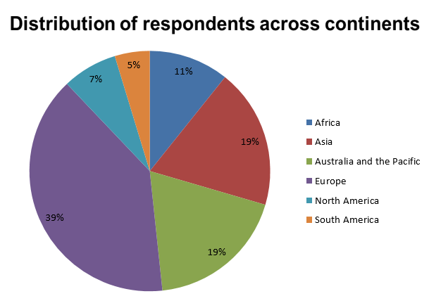
Foresight project “Access, Equity and Quality: Envisioning the Future of Higher Education in a Digital Age”
Online survey: 147 respondents from 54 countries: Europe (39%), Asia and the Pacific (19%), Africa (11%), North America (7%) and Latin America (5%)

Slide 17
Foresight project “Access, Equity and Quality: Envisioning the Future of Higher Education in a Digital Age”
Findings
The need for curriculum reform is due to such changes as the availability and development of OER
Varying readiness to acceptance, use and recognition of learning outcomes for OER and MOOCs
The impact of these developments on the change of the roles of teachers and institutions and the urgent need to (re)train teachers
The consequences of these developments for the way in which informal/ formal learning results are translated into credits and can be transferred and used
Price and quality expectations vary for the production of resources and delivery of education services, including those for people with disabilities

Slide 18
New Forms of Content Presentation and Credentialing
Unbundling of content
In 2003, the iTunes Store unbundled the CD. For the first time, consumers could purchase the songs they wanted rather than the bundle designated by the artist and label. Sales of digital singles soared but overall revenue fell 50 percent in a decade. Prior to this transformation, the business model for the music industry relied on bundling the music that consumers wanted (singles) with the music that they didn't want (the rest of the album). That meant the music industry made money it wouldn't have made without the bundle.
  "Unbundling” content is the future of education: Anant Agarwal, CEO, edX
Bundling has been central to the higher education business model for centuries. Colleges and universities combine content and a wide range of products and services into a single package, for which they charge "tuition and fees."

Slide 19
New Forms of Content Presentation and Credentialing
Digital badges and micro-credentials
The latest trend in higher education is micro-credentialing, the non-traditional education path where students gain skill sets in a specific area and receive a credential. This trend is very promising for life-long learning.
Micro-credentials (nanodegrees) take the form of a digital certificate, which may be a document or image file, or other official evidence that you've completed the necessary work. The organization that grants the micro-credential decides what they will provide, so be sure to check it's what you need before you begin.
In 2015, Udacity announced a new nanodegree (nanodegrees are ‘curriculums designed to help you become job-ready)’— the Android nanodegree in partnership with Gooogle.
Penn State’s College of Business launched an online bootcamp course, ‘Supply Chain Leadership Academy’, to educate “supply chain leaders of tomorrow in leadership and best practices in holistic supply chain management”.

Slide 20

THANK YOU!
Dr. Svetlana KNYAZEVA
UNESCO Institute for Information Technologies in Education
s.knyazeva@unesco.org
http://iite.unesco.org/
This presentation is licensed under the Creative Commons Attribution-ShareAlike (BY-SA) 4.0 license

